Slide 1
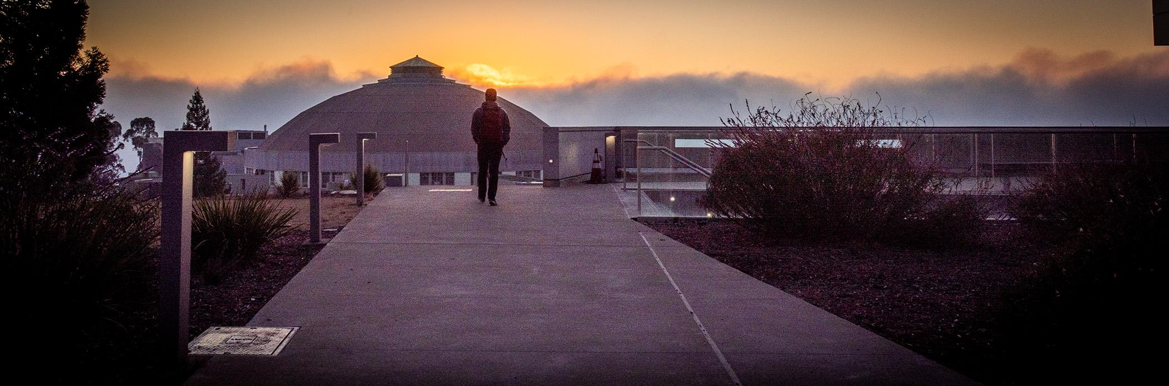
Reliable Novel Compute Methods for Unreliable Environments
Presenter: George Michelogiannakis
Applied Math and Computational Research Division (AMCR), LBNL
mihelog@lbl.gov

Slide 2
HPC’s Future If We Do Not Change Course
“Business as usual” is not sustainable
Credit: John Shalf, LBNL
Notes:
HPC performance development according to Linpack. The vertical axis is the factor of performance improvement for the sum of all systems on the Top500 list as measured by the Linpack benchmark. Whereas performance improved by a factor of 1000x every 11 years for the first 2 decades of the Top500, this figure has dropped precipitously in the past decade.

Slide 3
Today’s Topics
Superconducting digital computing
Reliable computation on unreliable hardware and environments
(at room temperature)

Slide 4
Superconducting Digital Computing

Slide 5
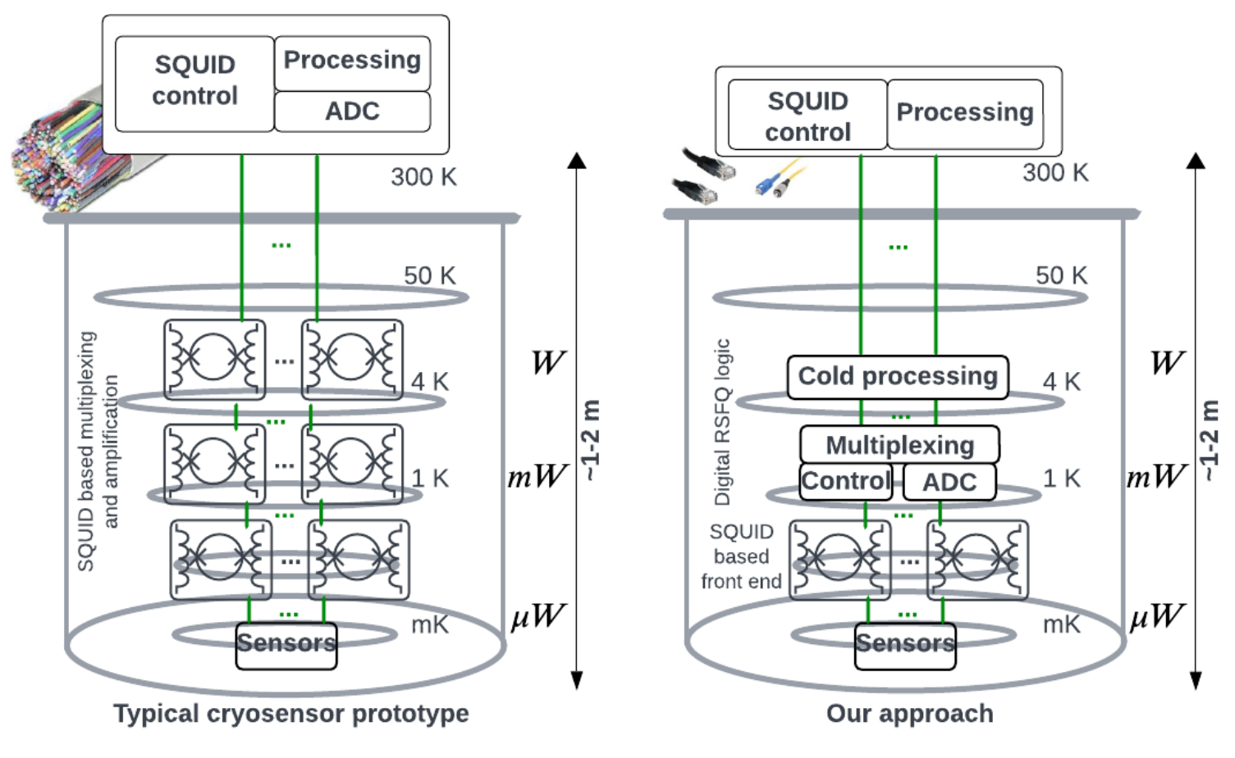
Move Compute Closer to Cryogenic Sensors/Qubits
Expensive and noise-prone cables to move data to room temperature
Lower temperature environments are more noisy

Slide 6
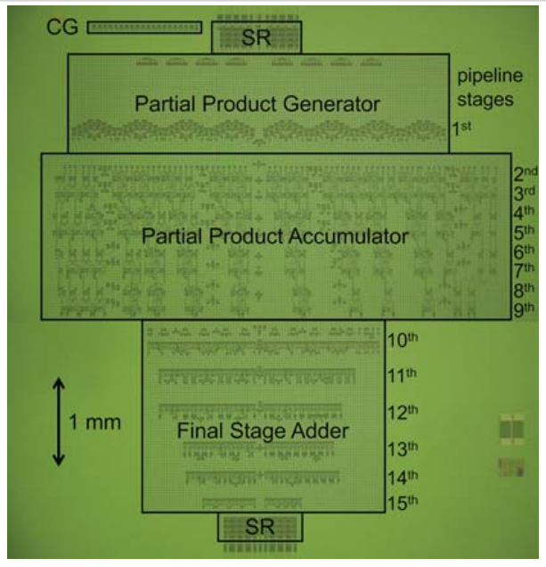
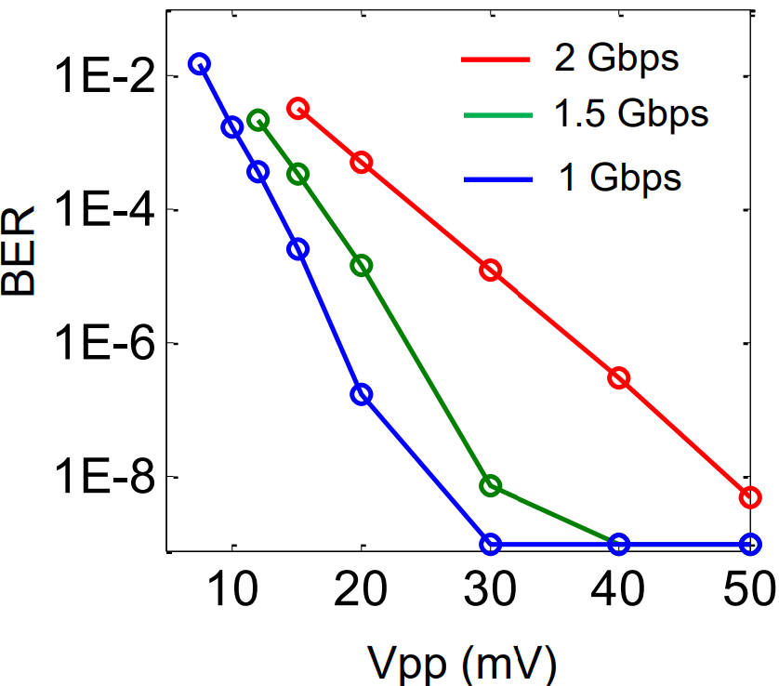
Challenges
Device density
Makes area a primary constraint
And memory capacity
Cables to room temperature
Reliability under harsh environments
Or with cooling and device variations
P Pintus et al., “Ultralow voltage, high-speed, and energy-efficient cryogenic electro-optic modulator”, Optica Vol. 9, Issue 10, pp. 1176-1182 (2022)
I Nagaoka et al., “A 48GHz 5.6mW Gate-Level-Pipelined Multiplier Using
Single-Flux Quantum Logic”, ISSCC 2019

Slide 7
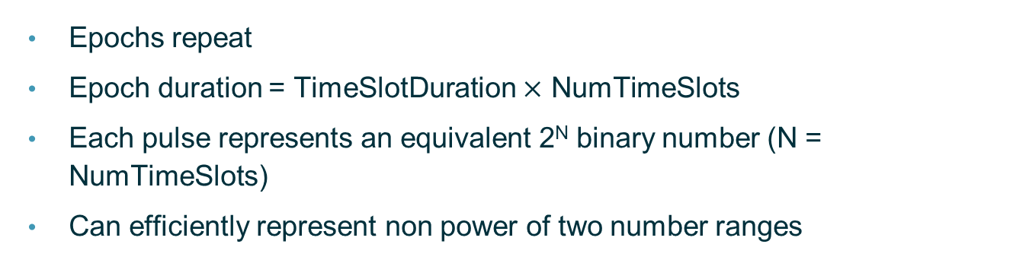
Data Encoding in Race Logic
An epoch contains N time slots. A pulse in time slot “I” encodes the value “I”
Epochs repeat
Epoch duration = TimeSlotDuration $×$ NumTimeSlots
Each pulse represents an equivalent 2^{N} binary number (N = NumTimeSlots)
Can efficiently represent non power of two number ranges
Epoch
0
1
2
3
4
Num = 1
Num = 4
Time
G Tzimpragos et al., “A computational temporal logic for superconducting accelerators”, ASPLOS 2020

Slide 8
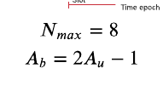
Instead: Unipolar and Bipolar Race Logic
Changing the range of representation to [0,1] (unipolar)
or [-1,1] (bipolar)
To obtain bipolar representation
Time epoch
Slot
RL
1
2
3
4
5
6
7
8
A = 3
Unipolar RL
0.125
0.25
0.375
0.5
0.625
0.75
0.875
1
A = 3/8
0 to 1
Bipolar RL
-0.75
-0.5
-0.25
0
0.25
0.5
0.75
1
-1 to 1
A = -0.25
P Gonzalez-Guerrero et al., “Temporal and SFQ pulse-streams encoding for area-efficient
superconducting accelerators”, ASPLOS 2022

Slide 9
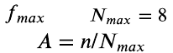
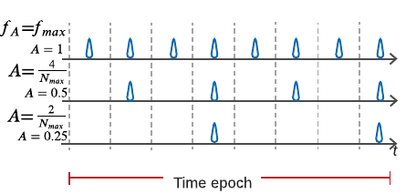
Pulse Train Operands
Maps a value to the number of pulses. “1” is for the maximum number of pulses
To obtain bipolar representation
(not shown)
P Gonzalez-Guerrero et al., “Temporal and SFQ pulse-streams encoding for area-efficient
superconducting accelerators”, ASPLOS 2022

Slide 10
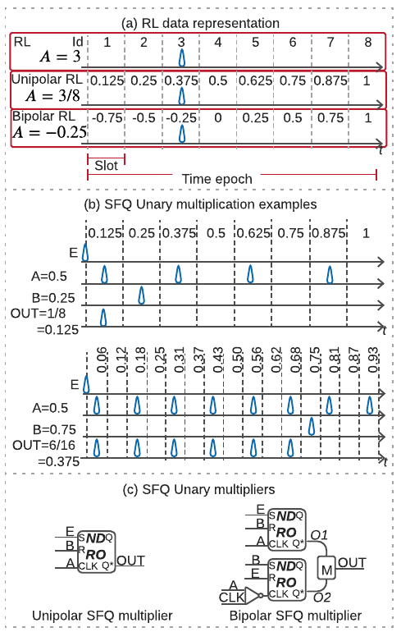
U-SFQ: Race Logic and Pulse Stream Operands
This shows a multiplication. The output is a pulse train
P Gonzalez-Guerrero et al., “Temporal and SFQ pulse-streams encoding for area-efficient
superconducting accelerators”, ASPLOS 2022

Slide 11
What is Keeping us Away From mK?
Such as 300 mK

Slide 12
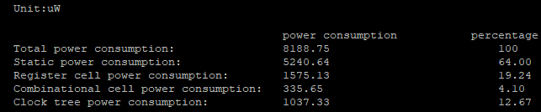
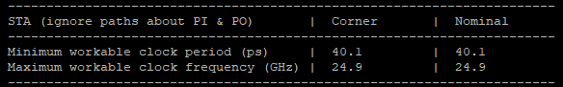
Power Limits
https://github.com/andreamurillomtz/decimation_filter.git
Simple 16-bit adder. Results with qPalace. 50% activity factor in every input
~1000x gap with μW target
How to reduce power?
ERSFQ/eSFQ (static power)
Fewer gates (smaller circuit)
Lower activity factor
Lower clock frequency
10mW active power
Notes:
1118 gates

Slide 13
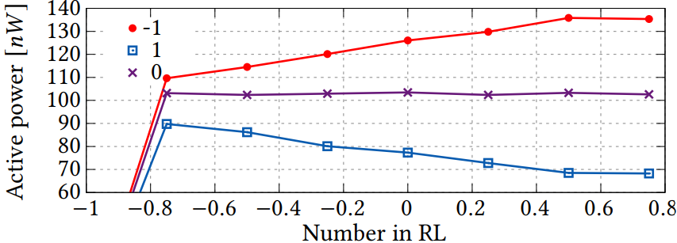
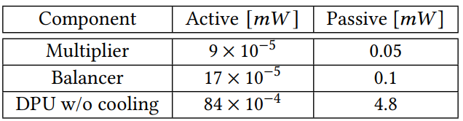
U-SFQ’s Power Requirements
Power depends on numerical value of inputs. Higher numbers -> more pulses
Active power consumption for the bipolar multiplier, using three different pulse
streams frequencies representing the numbers −1, 1, and 0. We vary the RL input from -1 to 1.
32-input 8-bit U-SFQ dot-product unit
RSFQ. RL and pulse train inputs set to half the maximum value
P Gonzalez-Guerrero et al., “Temporal and SFQ pulse-streams encoding for area-efficient
superconducting accelerators”, ASPLOS 2022

Slide 14
Noise / Variability
From external factors, cooling imperfections, and device variability
SFQ devices are usually biased around 70% of their switching voltage
If noise levels are high, fluctuations in voltage can cause JJs to produce erroneous pulses
SFQ devices due to their low switching energy and particularly susceptible
Noisy grounds and power supplies can cause issues with device performance
These are already challenges in 4K, worse at 300mK
SFQ devices need to be tuned
Can compute models accept device errors but bound the numerical error?
We need a solid noise model and resulting simulation models
0
1
2
3
4
Erroneous pulse appears
Notes:
Best paper I can find: https://iopscience.iop.org/article/10.1088/1742-6596/97/1/012041/pdf
How to calculate BER of a given RSFQ cell: https://ieeexplore.ieee.org/document/1211653
Electromagnetic shielding is important. SFQ circuits are susceptible to trapped flux, leading to inconsistent pulse generation. A double layer cryoperm shield is used to ensure the device is operating in a low field environment. A superconducting aluminium shield can also be used to protect the chip from stray or residual fields.
Shielding on the wiring has also been seem to be key. Metallic braiding is needed around all of the dc ribbons, both inside and outside the cryostat. Individually shielded twisted pairs are also being integrated into the system to reduce crosstalk / noise. Non-magnetic components must be used throughout the system, particularly around wire connections and device mount.

Slide 15
How Do Compute Models Affect Error?
Predictability of errors matters too, not just its numerical impact
For binary, pulse trains, and race logic:
How does an erroneous pulse appearing affect the represented value?
How about a pulse disappearing?
How about a pulse shifting?
Binary
Pulse shift: Small error
Pulse disappear: Zero!
Pulse appear: No error or lower value
Pulse shift: no numerical effect
Pulse disappear or appear: Small and bounded error
Erroneous pulse

Slide 16
Reliable Computation on Unreliable Devices and Environments

Slide 17

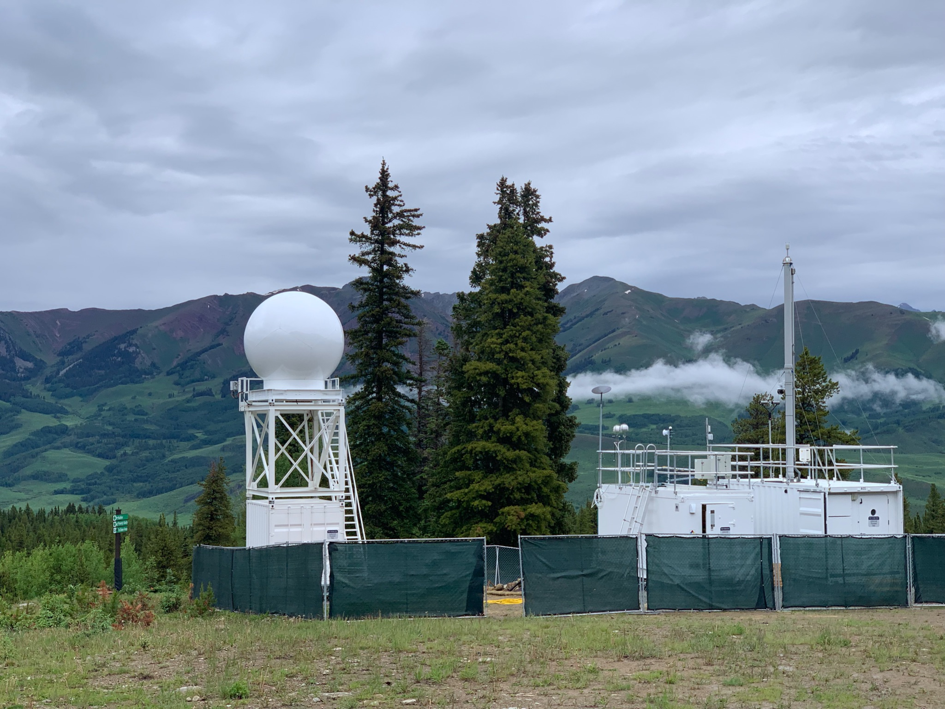
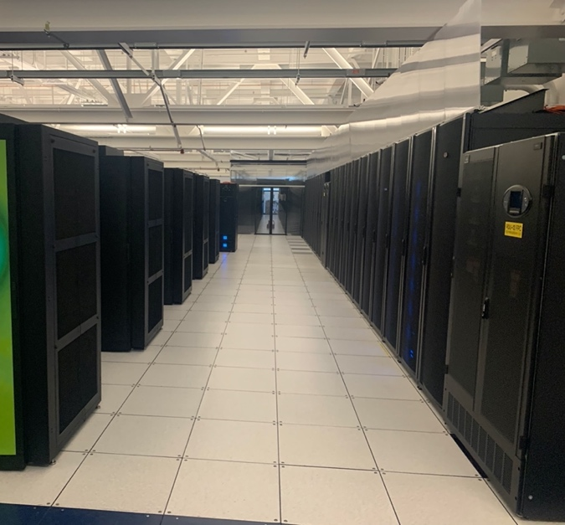


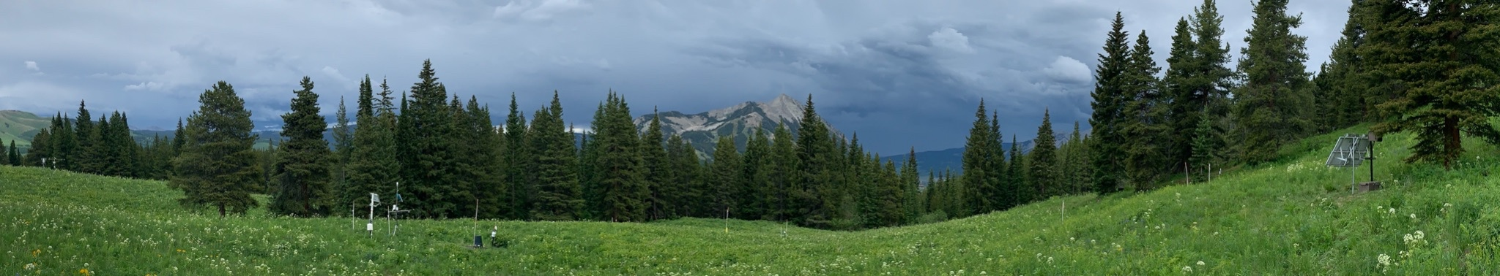



Reliable Distributed Computing With Unreliable Hardware in Unreliable Environments
STARLINK
5G network management
LBL
5G
5G
LTE
LoRa
WiFi
Notes:
These pictures are from sites in Alaska and Colorado that detect environmental changes and landslides. Other applications include radiation detection.
Reliability of the distributed computation is key. But also to reduce data movement from sensors to the system.

Slide 18
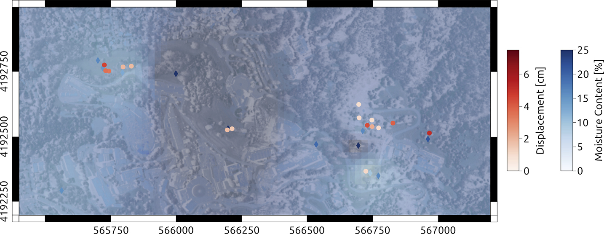
Landslide Monitoring
Geophysical sensors to derive a predictive understanding
Sensor density of more than 175 sensors per square kilometer
Map of the study site showing the measured and interpolated moisture content (diamond symbols and blue shades) and the measured deformation at a subset of the monitored locations (white to red dots)
“Predictive monitoring of urban slope instabilities using geophysics and wireless sensor networks”, The Leading Edge. 2023;42(9):634-643

Slide 19
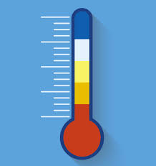

Reliable AI in an Unreliable Environment
Future work
With privacy in case communication is monitored or sensors get reverse engineered
Sensor1 observation
Sensor2 observation
Sensor3 observation
Sensor4 observation
Partial hypervector
Partial hypervector
Partial hypervector
Partial hypervector
Optional hashing step
Distributed or centralized
communication step
Entire hypervector in one location. Can produce final result
With many sensors, a minority of the hypervector missing will not affect final classification result, with high probability
Alternative models such as CNNs also possible but resilience has not been in focus yet
Notes:
Distributed CNNs: https://ieeexplore.ieee.org/document/9763736

Slide 20
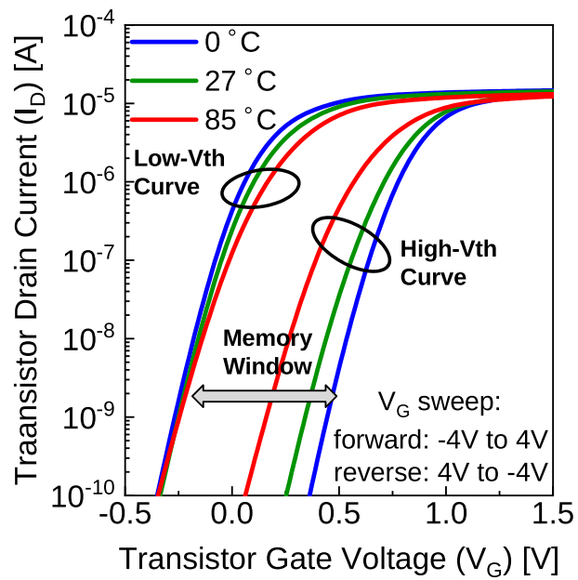
Bit Error Rate (BER) in Emerging Devices
Ferroelectrics as an example
BER depends on applied gate voltage, process variation, and temperature
BER is affected asymmetrically for 0s and 1s with temperature
0 to become 1 more probable
Almost a linear relationship
At 85C and different read voltages:
14nm FeFET, 10nm Fe layer
0.1V
P₀₁ = 2.198%
P₁₀ = 1.090%
0.25V
P₀₁ = 2.098%
P₁₀ = 0.190%
“FeFET-Based Binarized Neural Networks Under Temperature-Dependent Bit Errors”, IEEE Transactions on Computers, July 2022
Notes:
Linear relationship of BER (separately for 0s and 1s) and temperature.
0s and 1s means the probability for a 0 to become a 1, and 1 to become a 0.
Details on Our TCAD-Based Modeling of FeFET. As earlier mentioned, in our work the entire Ferroelectric FinFET (FeFET) device is fully implemented and modeled in Technology CAD (TCAD) framework (Synopsys Sentaurus). Concisely, we model and calibrate a 14nm FinFET device using TCAD, and then the high-k layer (1.7nm) in the gate stack is replaced with a 10nm ferroelectric layer (Hf0:5Zr0:5O2) located on top of the SiO2 layer. It is noteworthy that our device modeling is not just a combination of a Ferroelectric capacitor model and a FinFET model but, in fact, the complete ferroelectric FinFET device is fully modeled in TCAD using a meta-ferroelectric-insulator-semiconductor (MFIS) stacks. For accurate modeling, the density gradient model is used to account for the quantum confinement effects and, additionally, the thinlayer mobility model is used to account for the scaled fin dimensions. The crystal orientation effects on the channel mobility, channel strain-related mobility improvement, and ballistic mobility to account for the quasi-ballistic carrier transport in such nano-scaled dimensions have also been considered. T

Slide 21
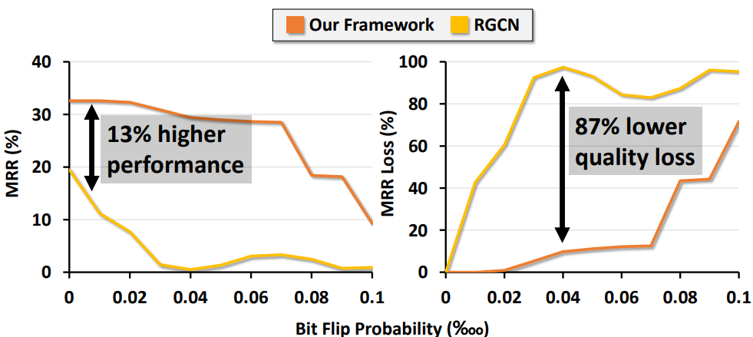
Reliable AI Models can Mask Bit Errors
So we can allow devices to be error prone thus more efficient
Framework based on hyperdimensional computing (HDC) and compared against a graph neural network (GNN)
Study includes models of FeFETs as well as FeFET hardware blocks for memory, element-wise vector product, and vector-matrix product
MRR: Mean reciprocal rank. X-axis on a per-thousand scale
MRR measures the average reciprocal rank of predictions, with higher scores indicating more accurate predictions ranked closer to the top
“Reliable Hyperdimensional Reasoning on Unreliable Emerging Technologies”, IEEE ICCAD, 2023
Notes:
It also includes quantization of hypervector values and elements.
MRR is a crucial metric to assess graph reasoning. The mean reciprocal rank is a statistic measure for evaluating any process that produces a list of possible responses to a sample of queries, ordered by probability of correctness. The reciprocal rank of a query response is the multiplicative inverse of the rank of the first correct answer: 1 for first place, ¹⁄₂ for second place, ¹⁄₃ for third place and so on. The mean reciprocal rank is the average of the reciprocal ranks of results for a sample of queries Q.

Slide 22

Conclusion
Lets adapt compute models to mask unreliability, reduce area, and reduce power
This will allow more efficient compute and in domains that are impractical now
Questions?

Slide 23
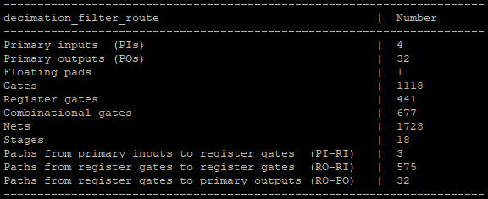
Power Limits
https://github.com/andreamurillomtz/decimation_filter.git
Simple 16-bit adder. Results with qPalace. 50% activity factor in every input
10mW active power
~1000x gap with μW target
How to reduce power?
ERSFQ/eSFQ (static power)
Fewer gates (smaller circuit)
Lower activity factor
Lower clock frequency

Slide 24
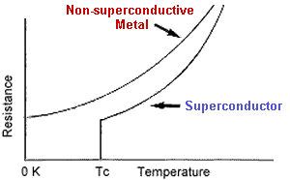
Background: Superconductivity
Resistance of mercury and other materials drops to near zero below ~4K
Gallardo et al, “Superconductivity observation in a (CuInTe 2 ) 1-x (NbTe) x alloy with x=0.5”

Slide 25
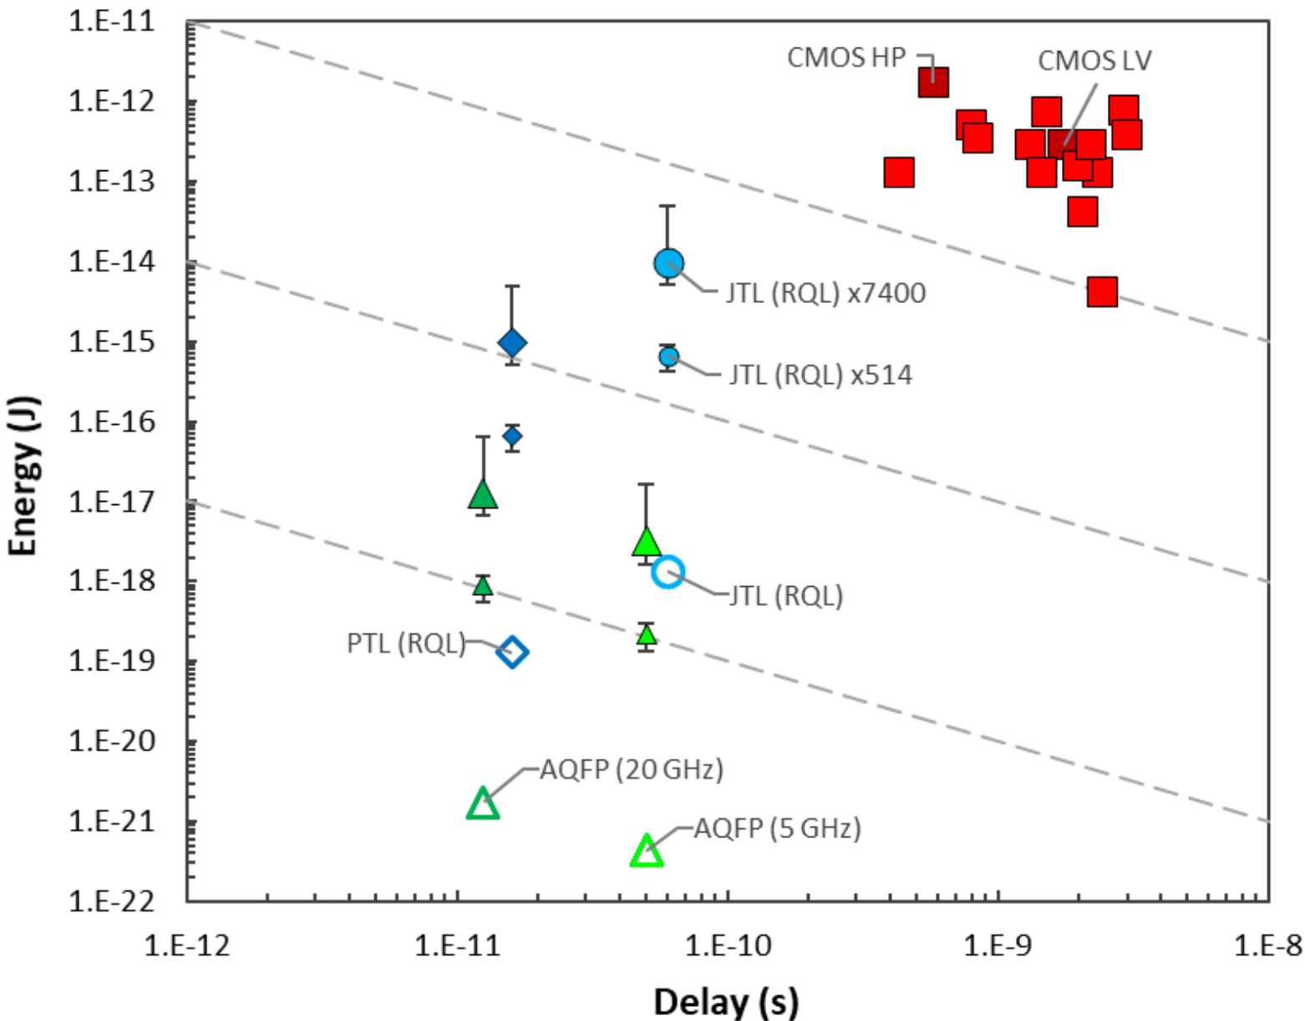
On-Chip Data Movement Efficiency is Impressive
May cause us to re-think architectures
IEEE International Roadmap for Devices and Systems, “Cryogenic Electronics and Quantum Information Processing.”

Slide 26
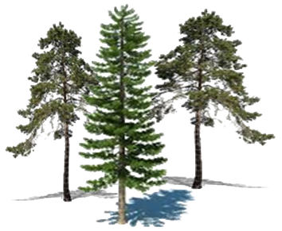
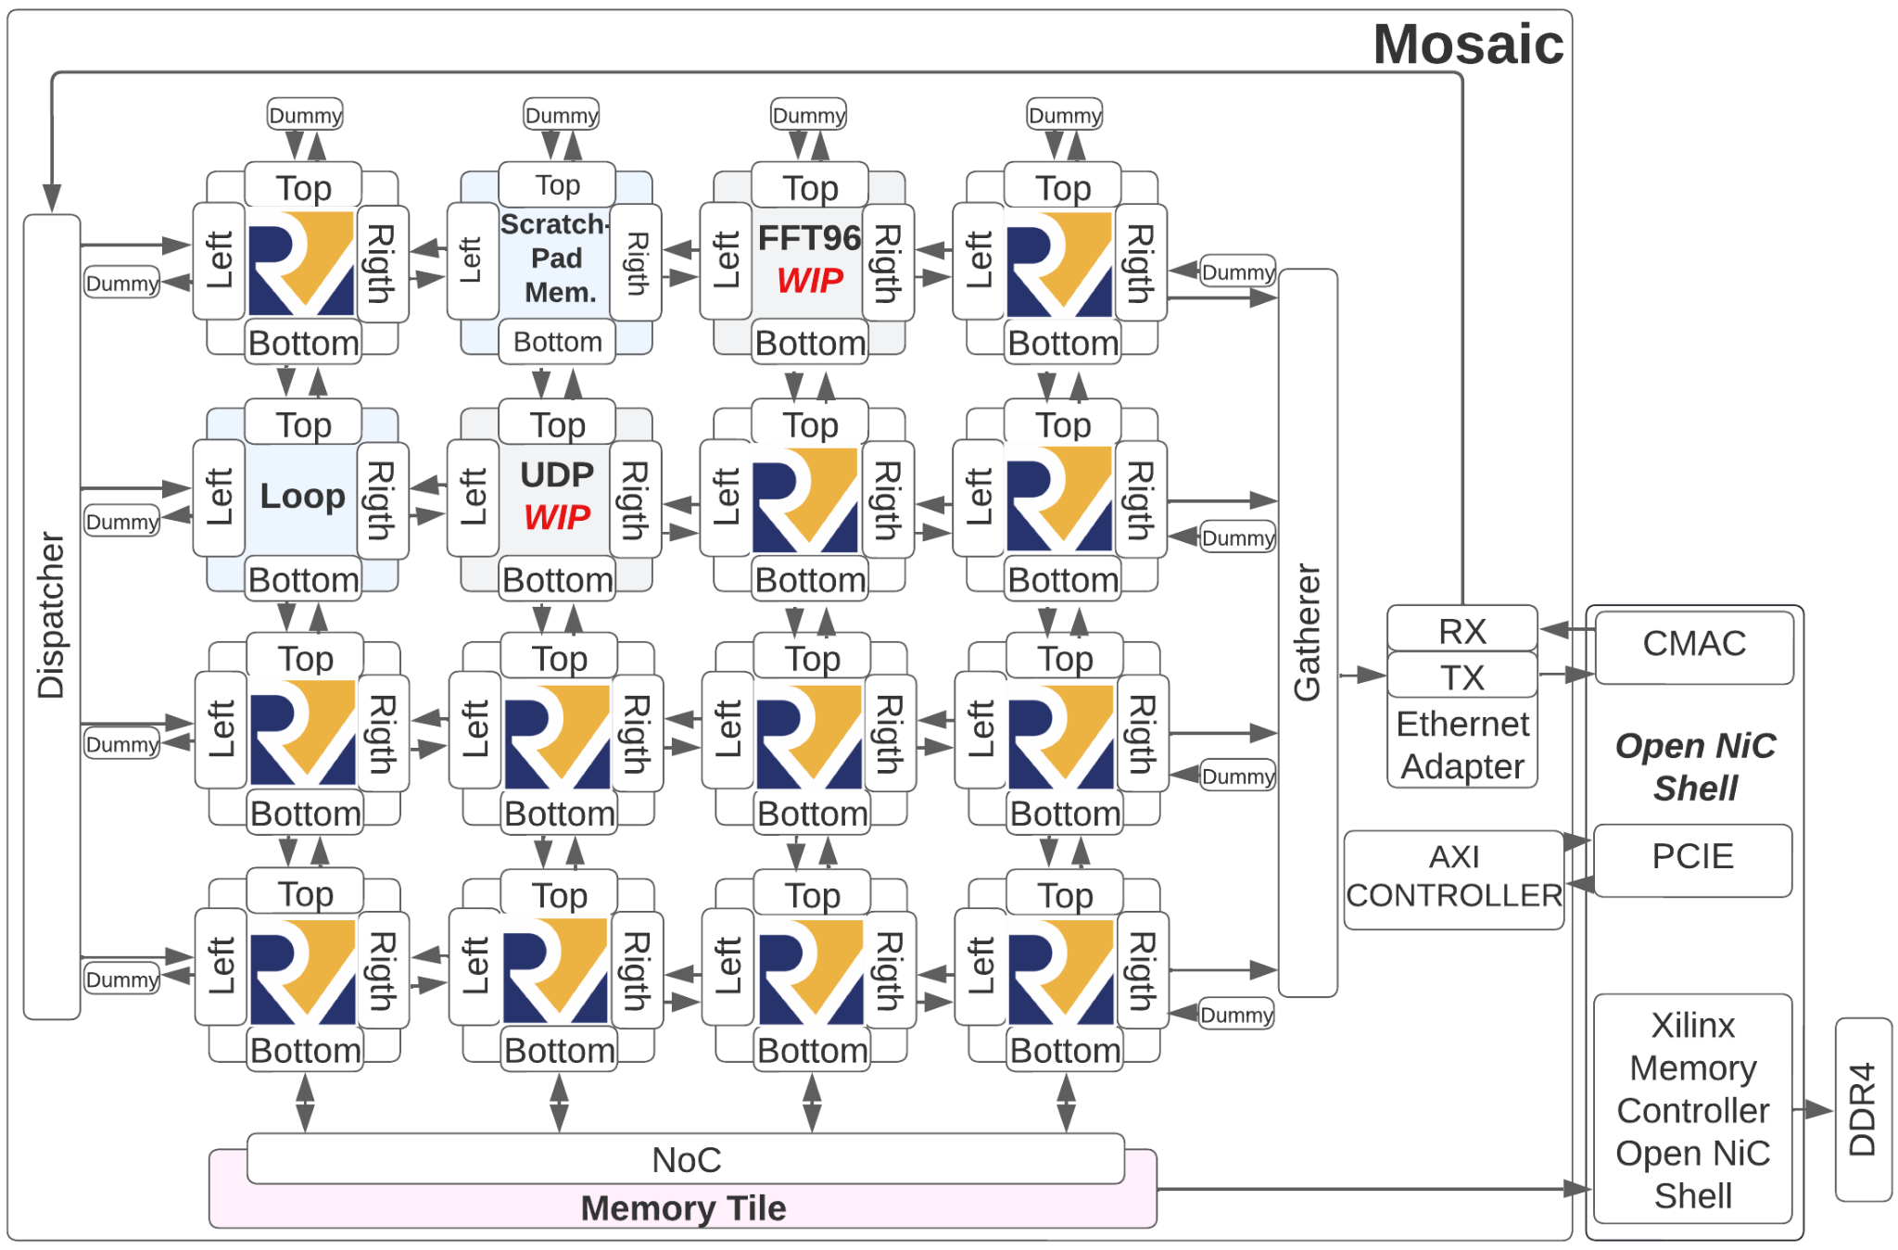
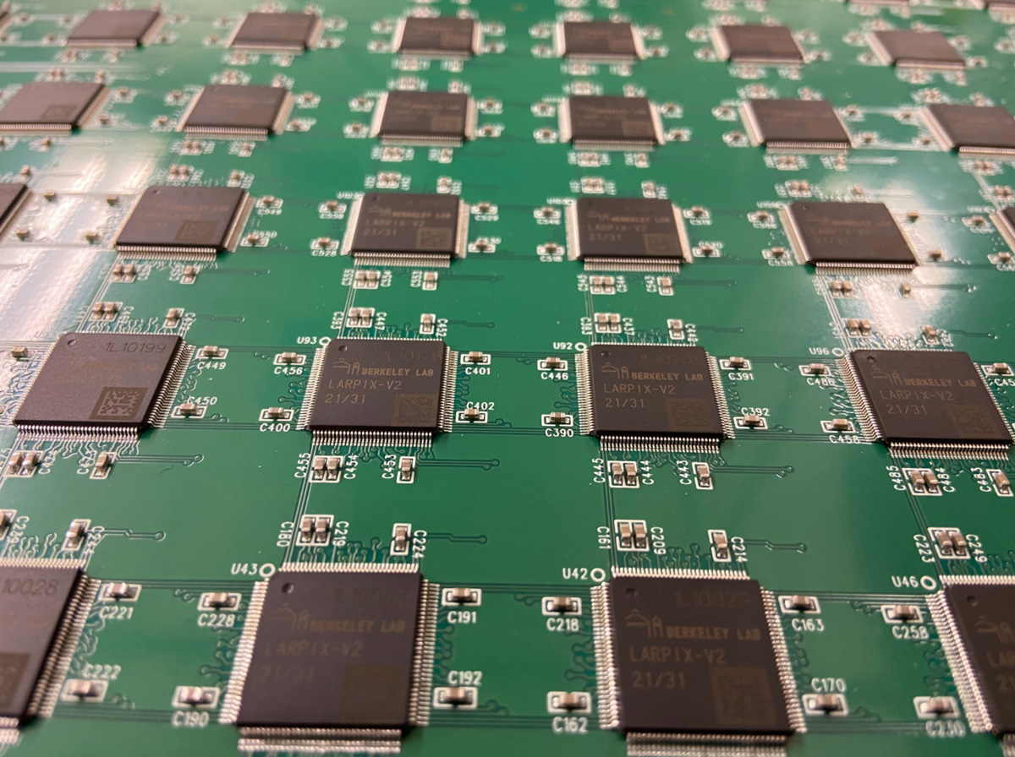

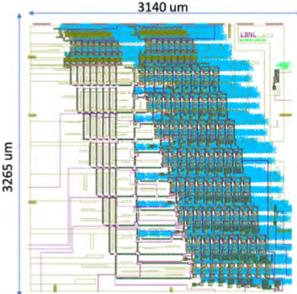
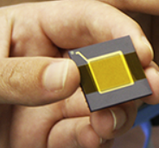
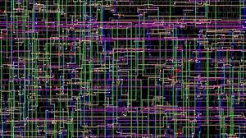

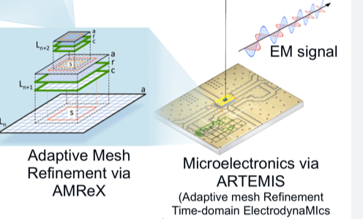
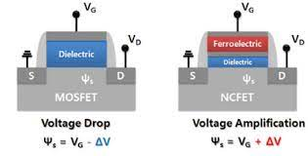


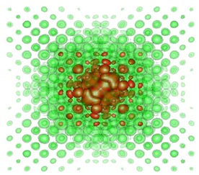
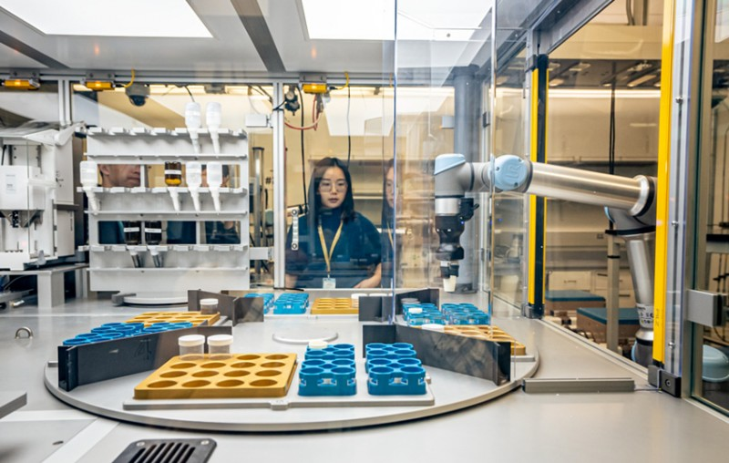

A Cross-Layer Approach With New Devices
Theory / Modeling / Simulation
(Applied Math and HPC)
100 Exaflops at < 20MW
Experiment /Synthesis / Prototype
(Experimental Facilities)
Cross-Validation
Systems
Resource Disaggregation
Photonic Interconnects
Neuromorphic/non-Von/compute
PINE
MoSAIC
Circuits
Automated std. cell generation
EDA/Circuit Synthesis
Superconducting Race Logic
Devices
ncFET and MESO, Superconducting
Spin-orbit magnetoelectric logic/mem
EUREKA EUV Patterning
Materials
Superconducting Materials
Ferroelectrics, Multiferroics
Robotic/automated synthesis (A-Lab)
A-Lab
Notes:
Jackie alvarez fellow
Talk a-lab
Building these connections is harder than it looks
We view ourselves as ASCR’s mcroelectrionics lab

Slide 27
Multiplication With Just One or Four Cells
Essentially a CMOS XNOR
The bipolar multiplier for stochastic computing
Before “B”, pulses in “A” pass
After “B”, the complement of “A” pass
The output is their merge
“Clk” denotes time slot boundaries
P Gonzalez-Guerrero et al., “Temporal and SFQ pulse-streams encoding for area-efficient
superconducting accelerators”, ASPLOS 2022
Notes:
Bipolar multiplier: Before the arrival of the RL pulse B, the top NDRO lets the pulse stream A pass through. As a result, 𝑂 1 = 𝐴 ∧ 𝐵 . When B arrives, it sets the bottom NDRO letting ¬ 𝐴 pass. As a result, 𝑂 2 = ¬ 𝐴 ∧ ¬ 𝐵 . The merger combines 𝑂 1 and 𝑂 2 obtaining 𝑂 𝑈𝑇 = ( 𝐴 ∧ 𝐵 ) ∨ (¬ 𝐴 ∧ ¬ 𝐵 ).
Given two numbers $p_A$ and $p_B$ in the range of $[0,1]$, we propose to encode $p_A$ as the rate of an SFQ pulse stream A, and $p_B$ as a RL signal B. To calculate $p_A \times p_B$, we use the RL signal B to filter out a percentage of pulses from A (see Figure~\ref{fig:rl_unip}b). What remains after the filtering process, encoded in a pulse stream, is the multiplication result. To implement this, we use an NDRO cell as shown in Figure~\ref{fig:rl_unip}c (left).
Using a single NDRO, we can multiply positive numbers. That is called unipolar multiplication. To multiply negative numbers, we propose a bipolar multiplier shown in Figure~\ref{fig:rl_unip}c (right). Notice that the proposed multiplier is inspired by a CMOS XNOR, that is the bipolar multiplier for stochastic computing~\cite{gaines1967}. Before the arrival of the RL pulse B, the top NDRO lets the pulse stream A pass through. As a result, $O1=A\wedge B$. When B arrives, it sets the bottom NDRO letting $\neg A$ pass. As a result, $O2=\neg A\wedge \neg B$. The merger combines $O1$ and $O2$ obtaining $OUT = (A\wedge B) \vee (\neg A\wedge \neg B)$.

Slide 28
Problem Statement: RL Arithmetic is Expensive
For instance, multiplying two race logic pulses
0
1
2
3
4
Num = 2
0
1
2
3
4
Num = 2
0
1
2
3
4
Num = 4

Slide 29
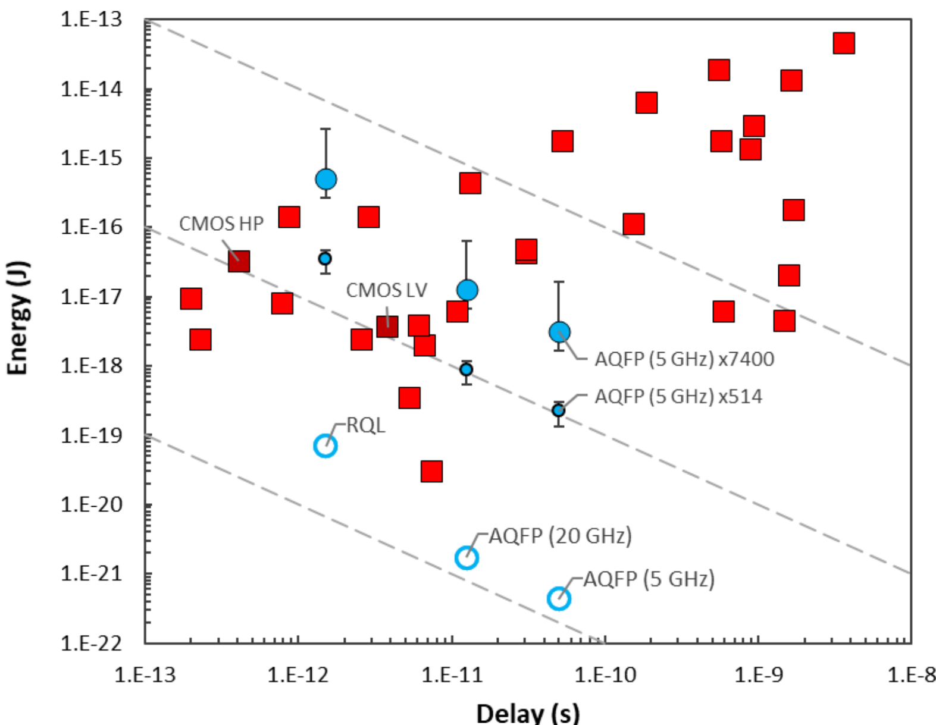
What is the Motivation?
Remember that manufacturing is generations behind CMOS
IEEE International Roadmap for Devices and Systems, “Cryogenic Electronics and Quantum Information Processing.”

